Slide 1
DETECTION OF HUMAN ACTIVITY USING MACHINE LEARNING TECHNIQUES WITH SMARTPHONE SENSOR DATA ANALYSIS
Dumpali Sharath Chandra Reddy 00864049
Kannanoor Spurgeon 00865266

Slide 2
Presentation Outline
Dataset
Advantages
Workflow diagram and Use Case diagram
Algorithms
Modules
System Requirements
Outputs and Results
Conclusion
References

Slide 3
Dataset
Preparing the Dataset(Example given dataset- by your convenient) The dataset is now supplied to machine learning model on the basis of this data set the model is trained. Every new data details filled at the time of application form acts as a test data set.
Variable | Description
Smart Phone | IQOO Z5
Sensors | Accelerometer and Gyroscope
Axis | 3-axis(x, y, z)
No. of volunteers | 30
Volunteers Age | 19-48
Features | 19
Activates | WALKING ,SITTING ,STANDING ,LAYING

Slide 4
Advantages:
These reports are to the investigation of applicability of machine learning techniques for human Activity Recognition in operational conditions.
Finally, it highlights some observations on future research issues, challenges, and needs

Slide 5
Work flow diagram
Source Data
Data Processing and Cleaning
Training Dataset
Testing
Dataset
Classification ML Algorithms
Best Model by Accuracy
Finding Human activity

Slide 6
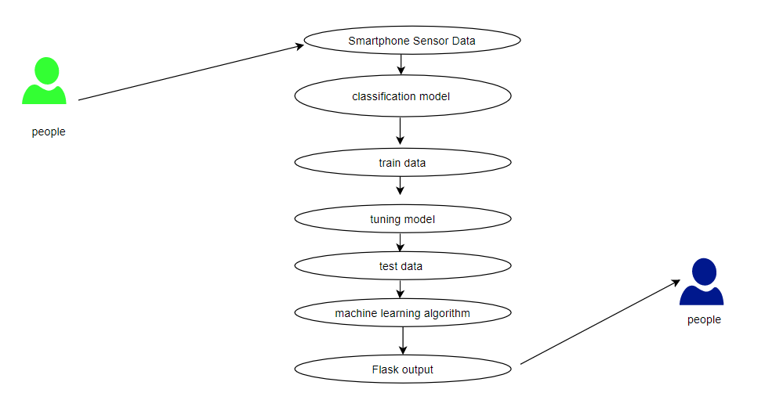
Use Case Diagram

Slide 7
Algorithms
The algorithms will evaluate a diverse set of nonlinear and ensemble machine learning algorithms, specifically:
Nonlinear Algorithms:
Linear Regression
Support Vector Machine
KNN Algorithm
Ensemble Algorithms:
Decision Trees
Random Forest

Slide 8
Modules
Data validation process (Module-01)
Data Visualization and Splitting dataset(Module-02)
Accuracy results of Logistic Regression algorithm (Module-03)
Accuracy results of Linear Support Vector Classifier(Module-04)
Accuracy results of SVM algorithm (Module-05)
Accuracy results of Decision Tree algorithm (Module-06)
Accuracy results of Random Forest algorithm (Module-07)
Accuracy results of KNN Algorithm(module-08)
Comparison between performance of all the algorithms(module-09)
GUI based prediction results of human activity (Flask)

Slide 9
System Requirements
Software Requirements
Operating System : Windows
Tool : Anaconda with Jupyter Notebook
Hardware Requirements
Processor : Pentium IV/III
Hard disk : minimum 80 GB
RAM : minimum 2 GB

Slide 10
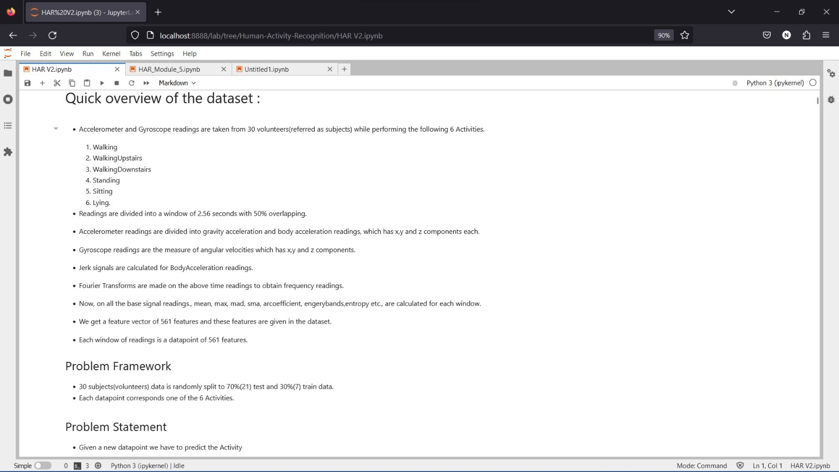
Results and Output Module1 : Data Validation Process

Slide 11
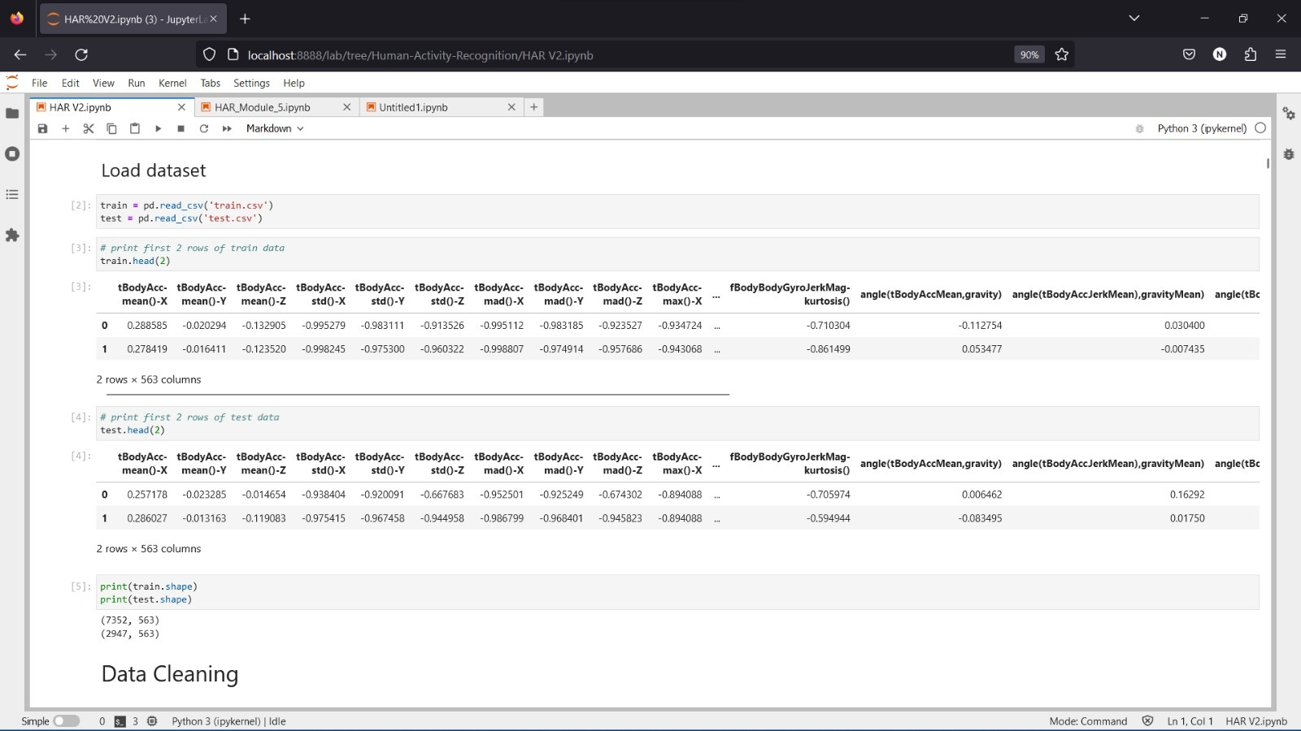

Slide 12
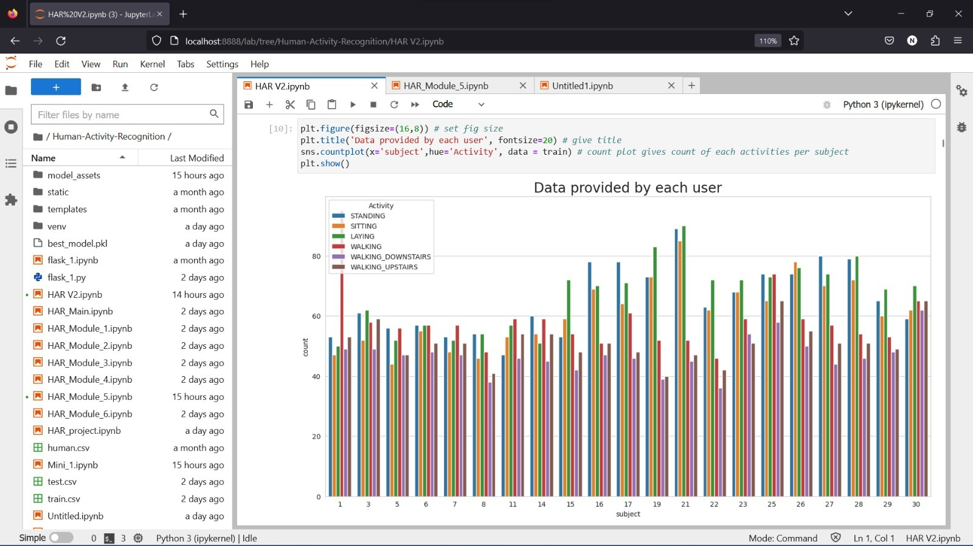
Module 2 : Data Visualization and splitting the data set

Slide 13
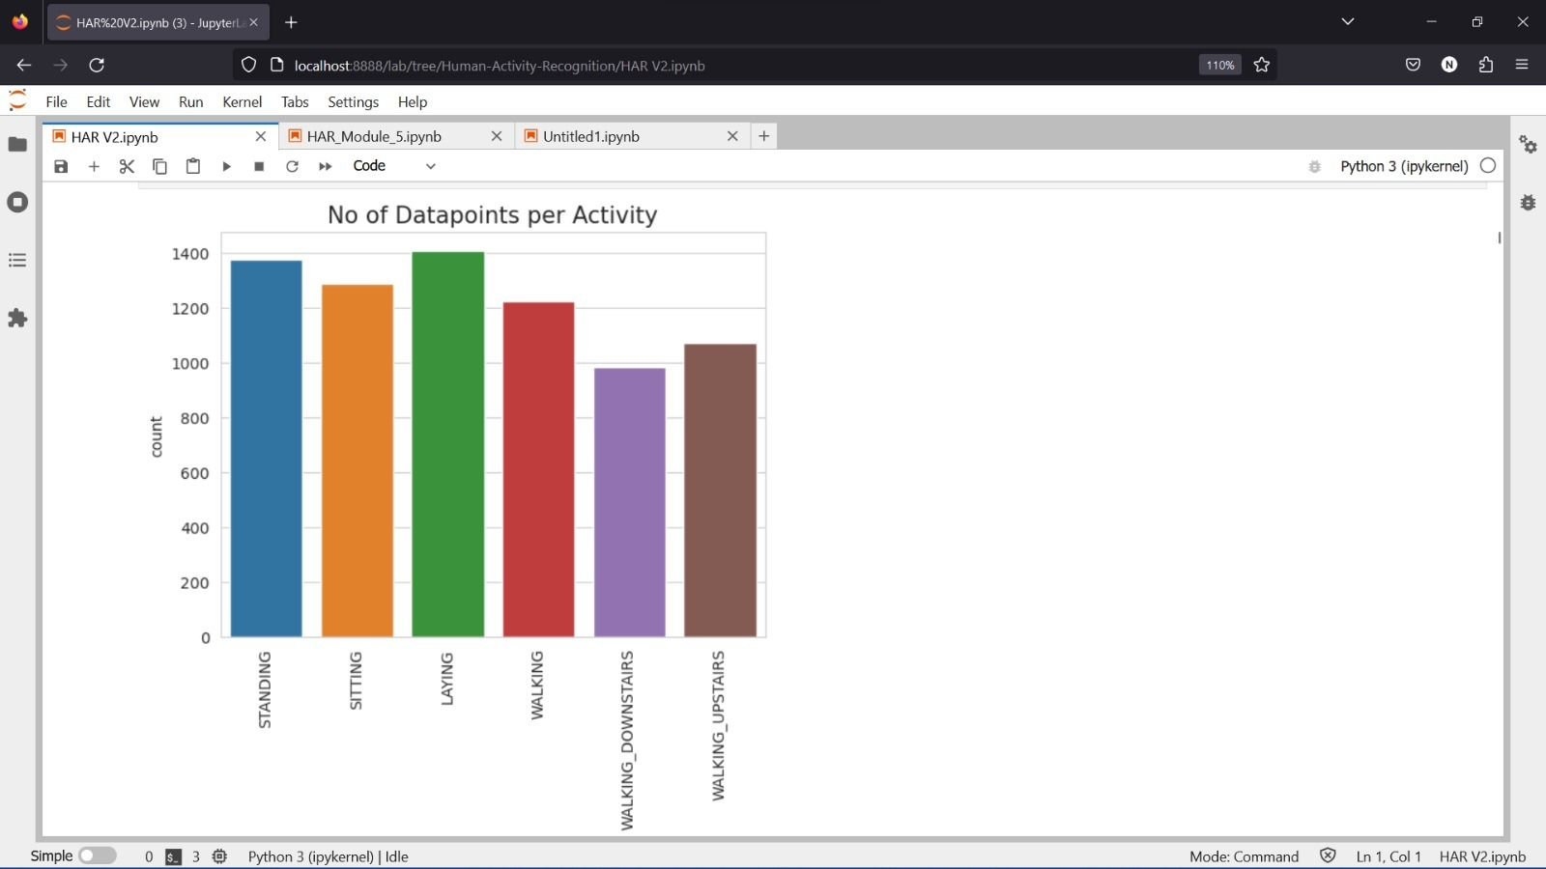

Slide 14
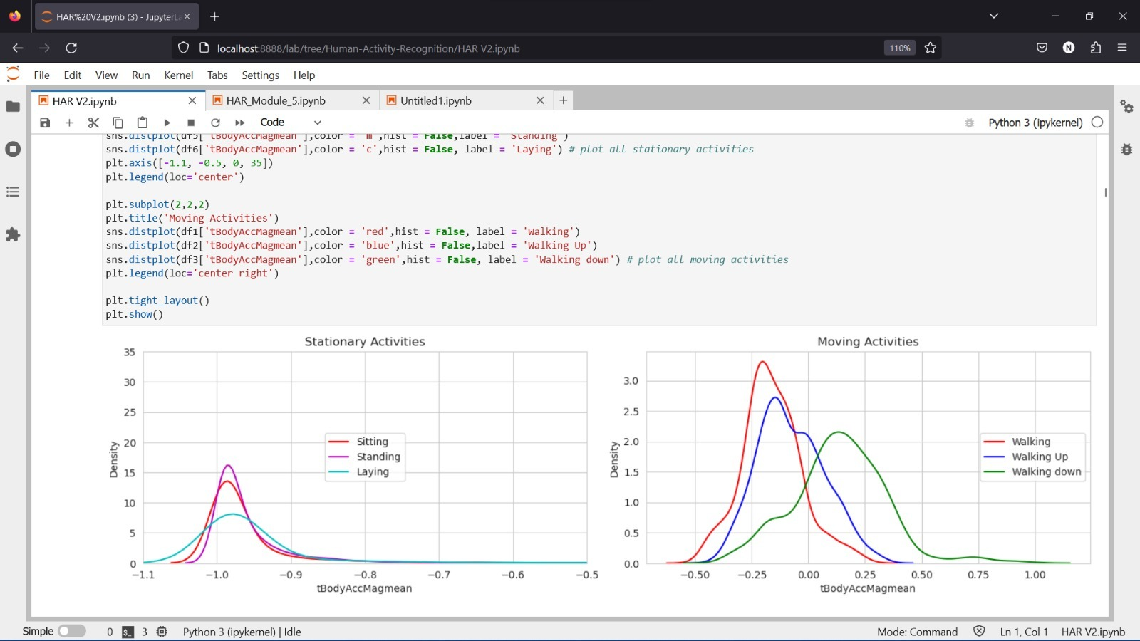

Slide 15
Observation
From above plot we can see that for dynamic activites 'tBodyAccMagmean' features value is more than -0.5. So that we can easily distinguish stationary activities and moving activities.

Slide 16
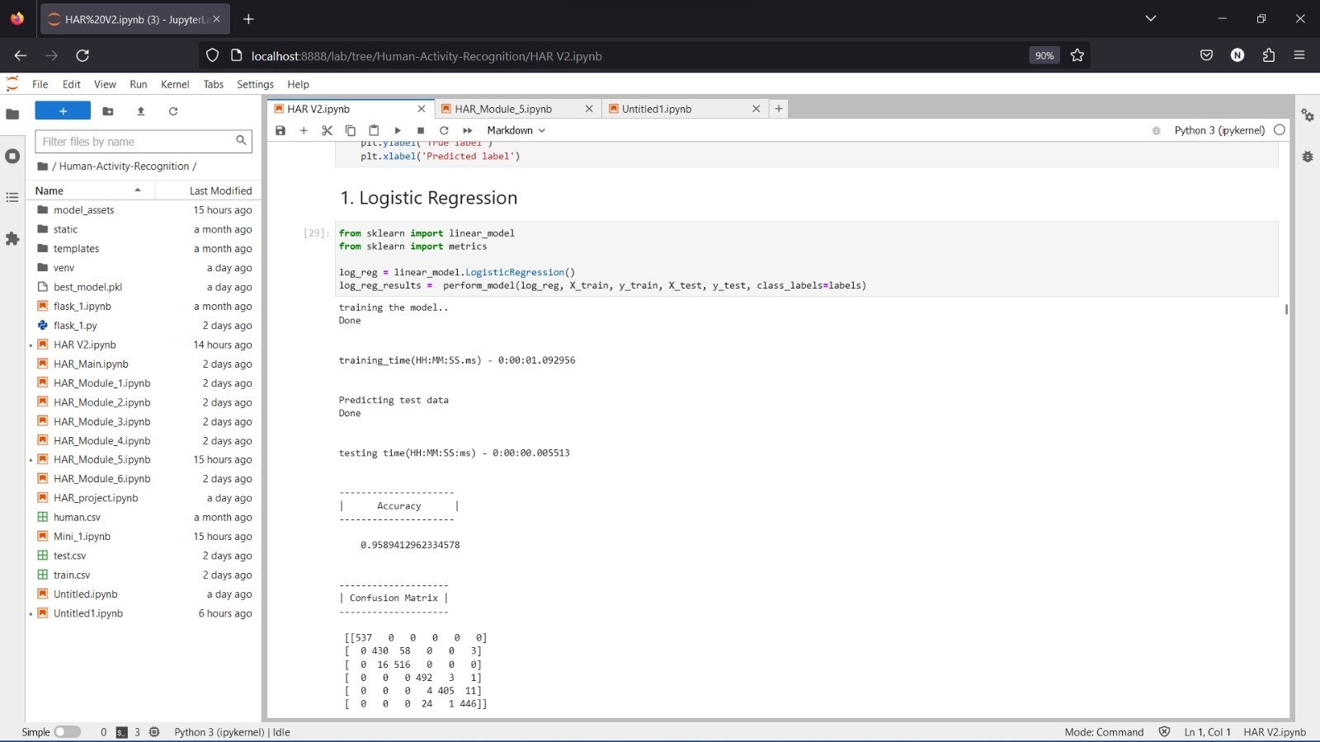
Module 3 : Accuracy results of Logistic Regression algorithm

Slide 17
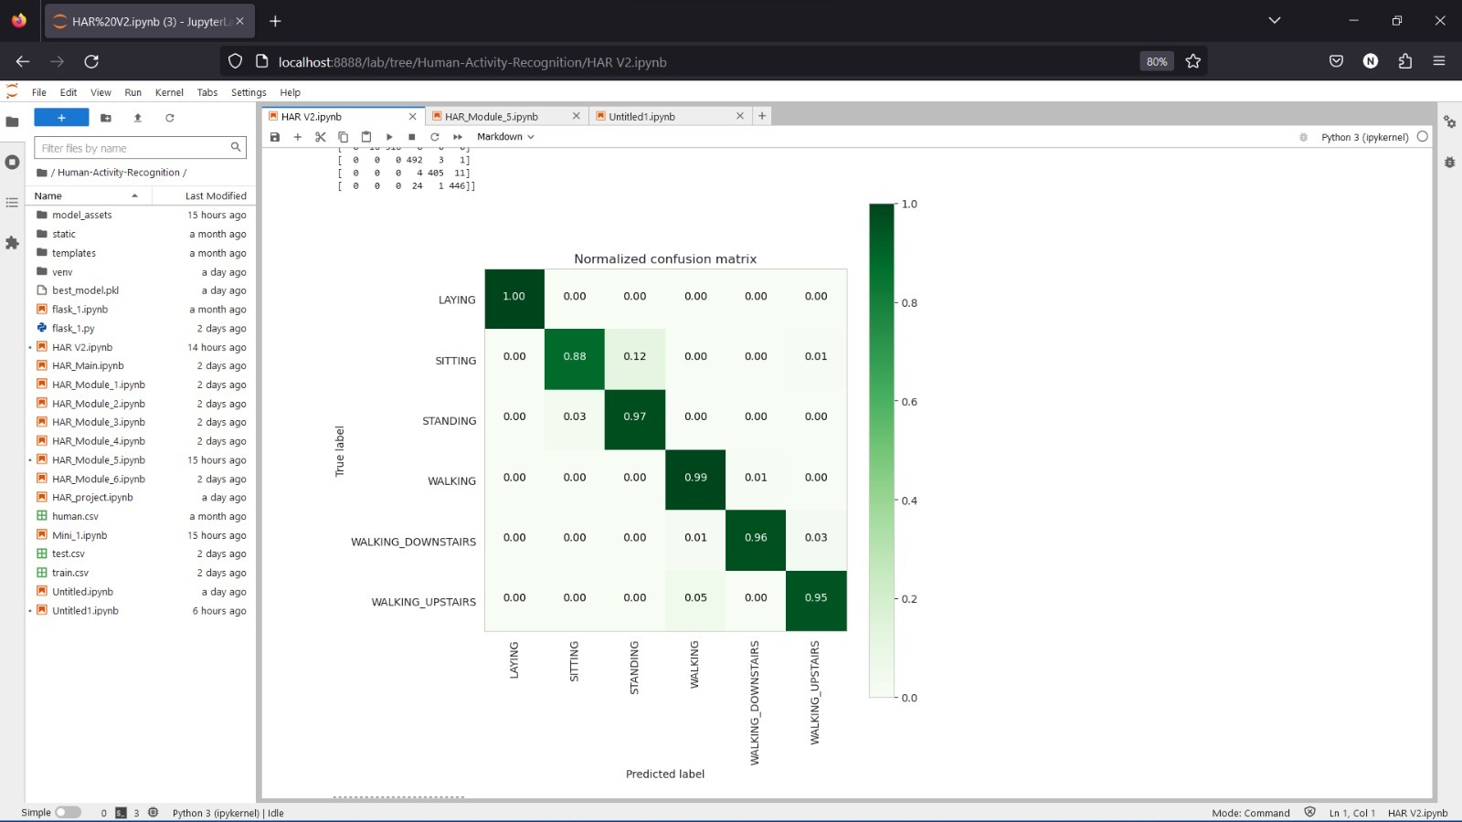

Slide 18
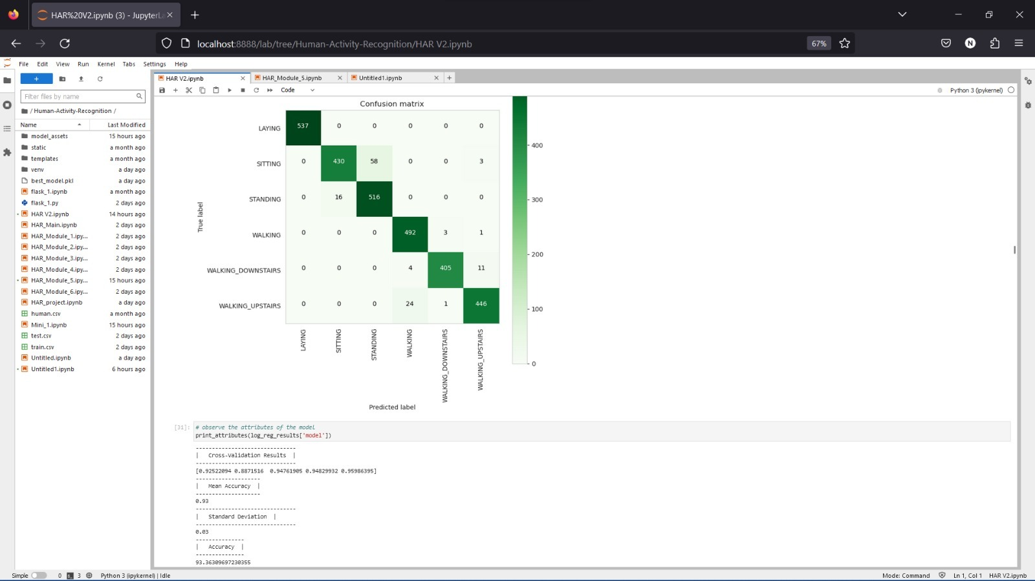

Slide 19
Observation
We got 93.36% test accuracy. From confusion matrix we can clearly see that, there are more wrong predictions between standing and sitting classes. By observing tsne plot we have observed that these two classes are overlapped.

Slide 20
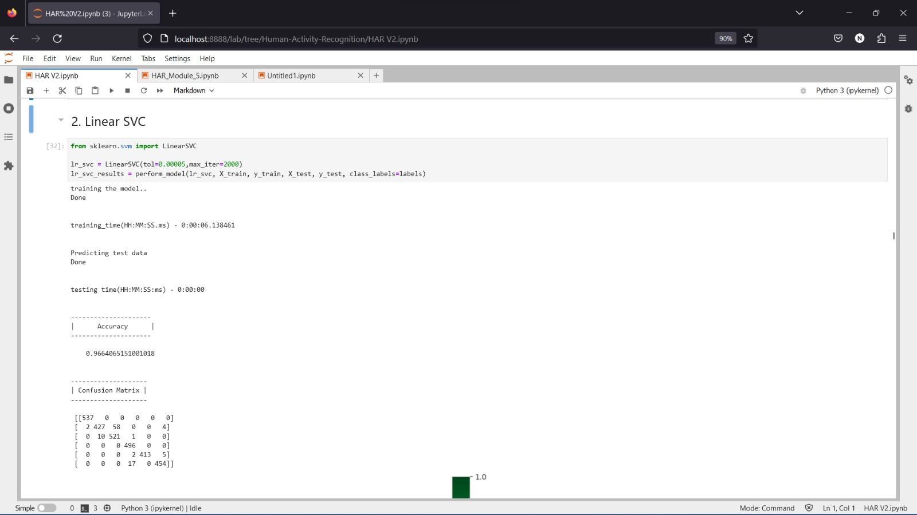
Module 4: Accuracy results of Linear SVC

Slide 21
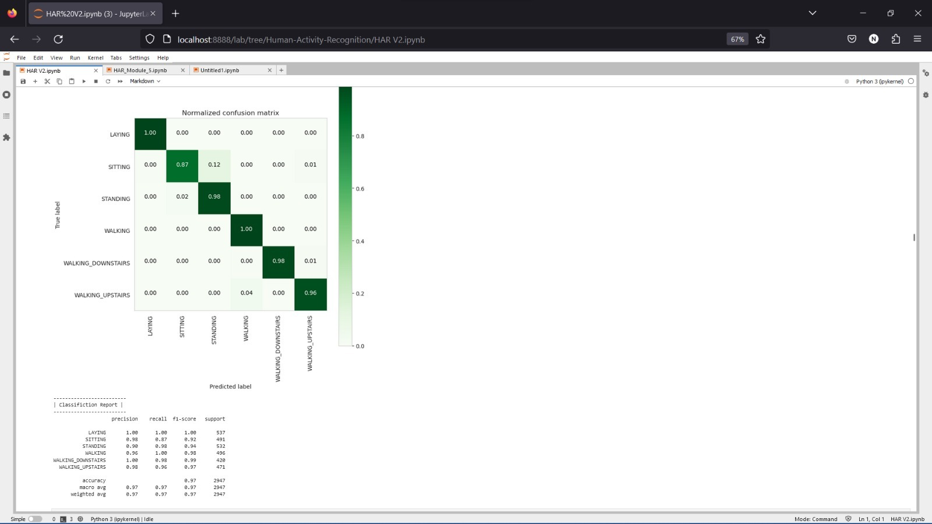

Slide 22
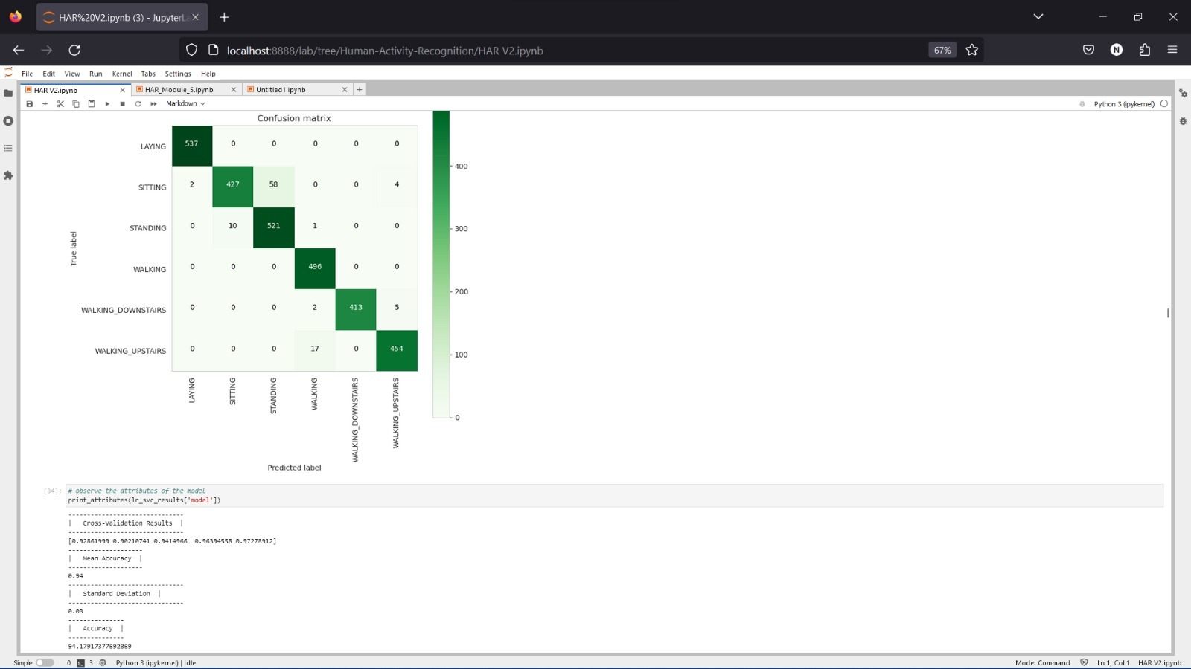

Slide 23
Observation
We got 94.11% test accuracy. From confusion matrix we can clearly see that, there are more wrong predictions between standing and sitting classes.By observing tsne plot we have observed that these two classes are overlapped. And also there are few wrong predictions between walking, walking downstairs and walking upstairs classes. By observing tsne plot we have observed that these three classes are overlapped.

Slide 24
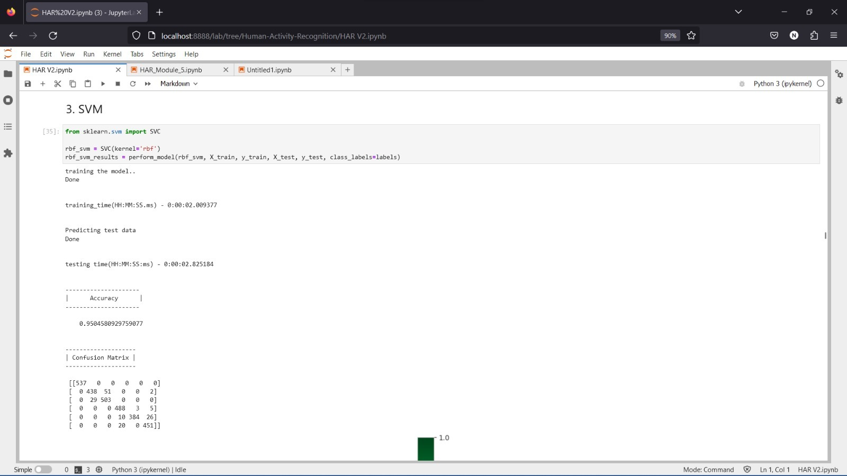
Module 5 : Accuracy results of SVM algorithm

Slide 25


Slide 26
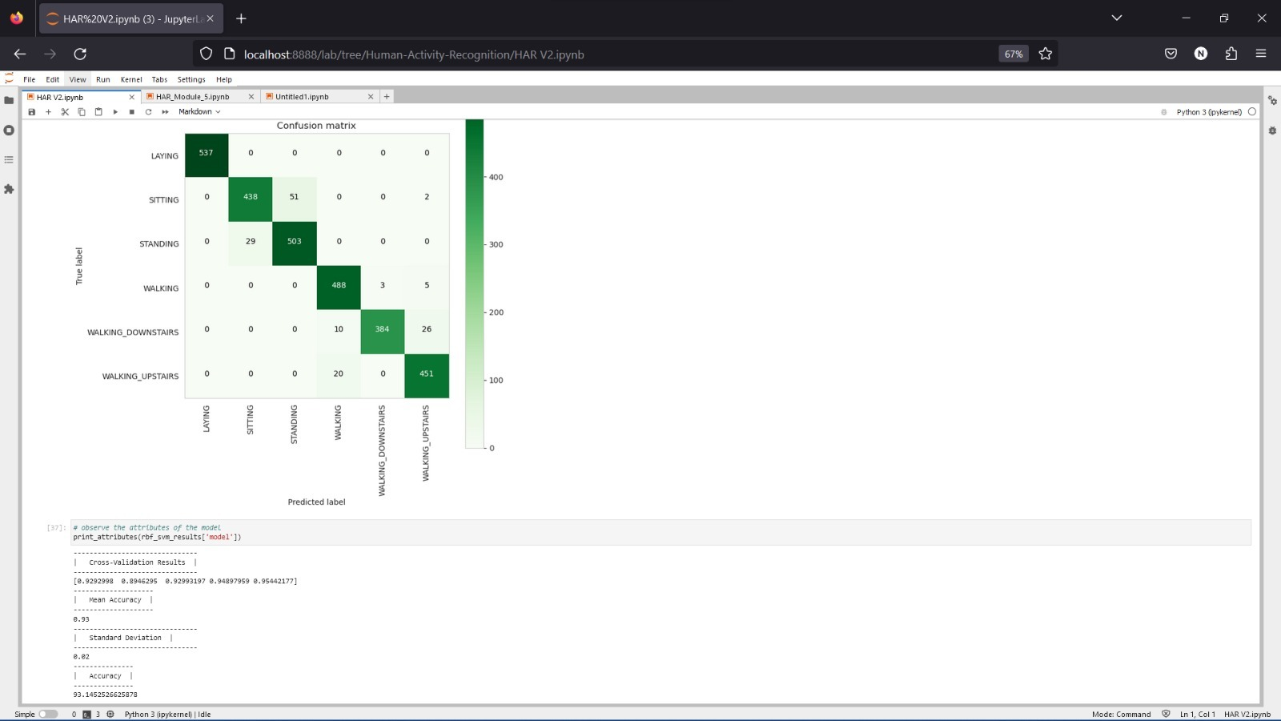

Slide 27
Observation
We got 93.14% test accuracy. From confusion matrix we can clearly see that, there are more wrong predictions between standing and sitting classes. By observing tsne plot we have observed that these two classes are overlapped. And also there are more wrong predictions between walking, walking downstairs and walking upstairs classes. By observing tsne plot we have observed that these three classes are overlapped..

Slide 28
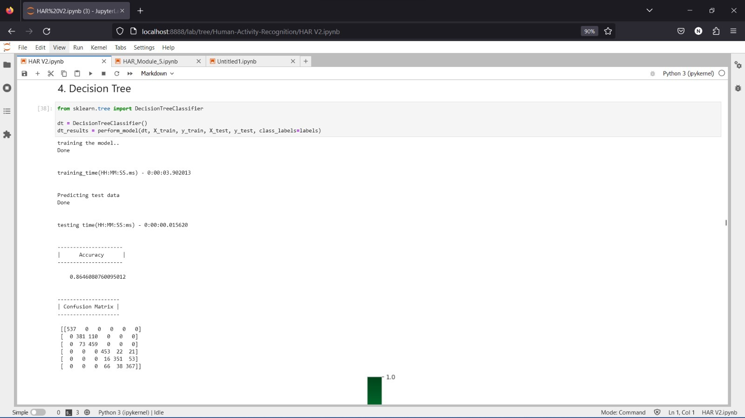
Module 6 : Accuracy results of Decision Tree Algorithm

Slide 29
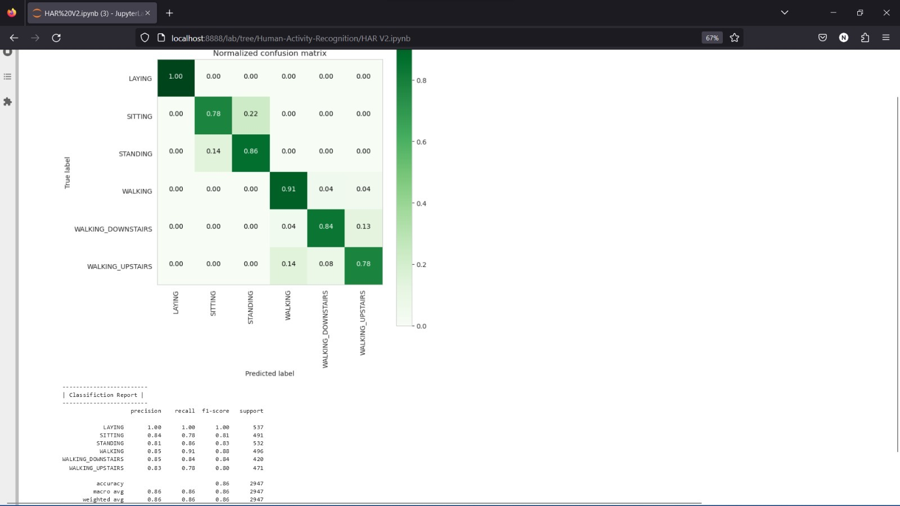

Slide 30
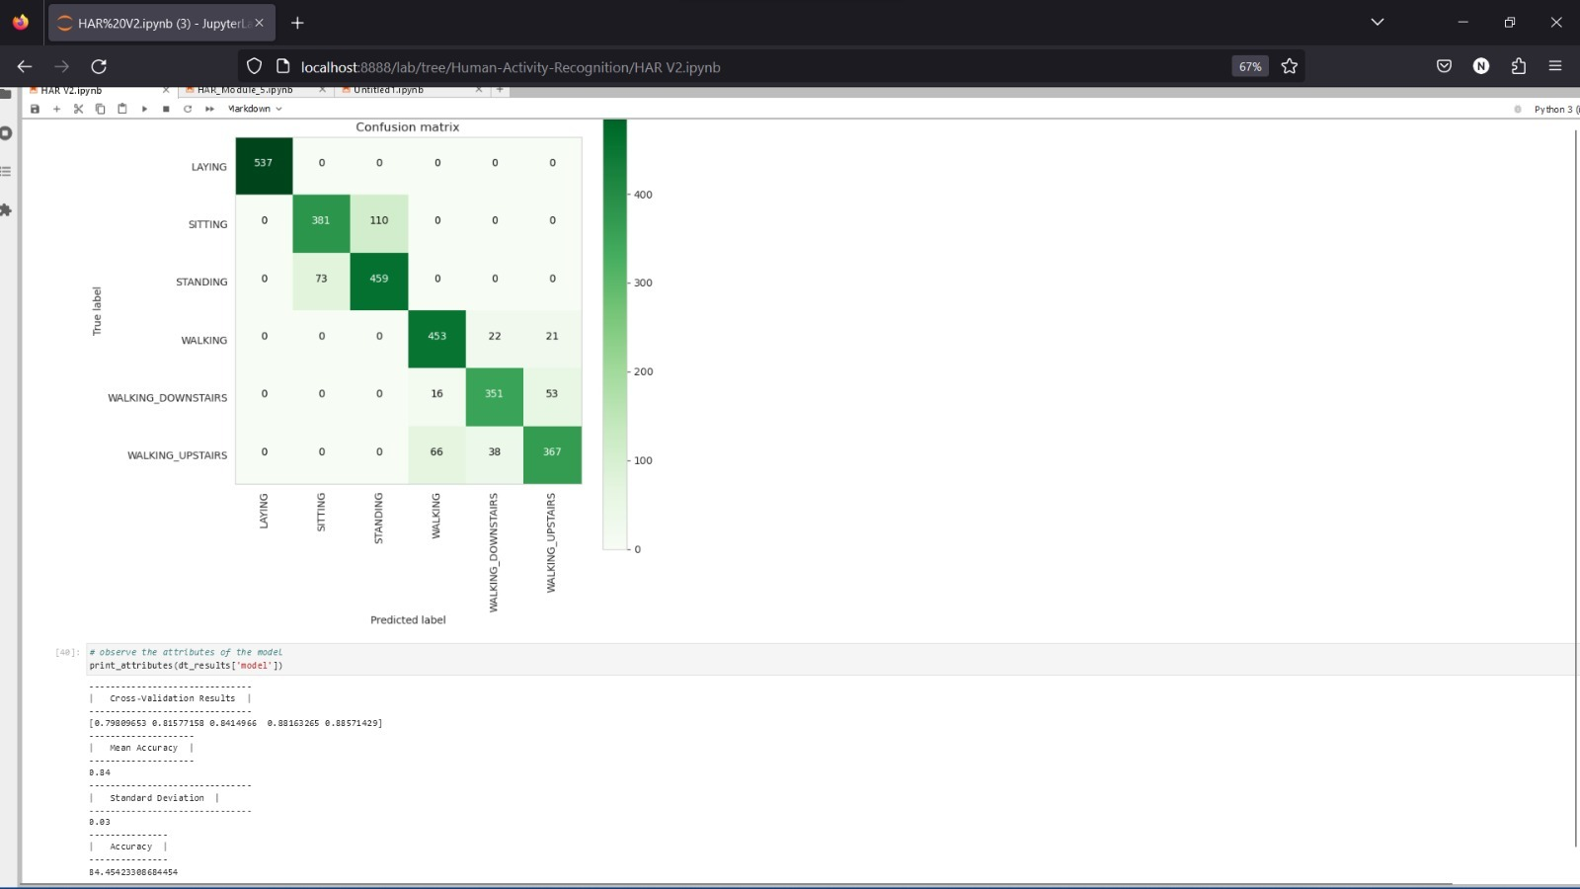

Slide 31
Observation
We got 84.37% test accuracy. From confusion matrix we can clearly see that, there are large number of wrong predictions between standing and sitting classes. By observing tsne plot we have observed that these two classes are overlapped. And also there are more wrong predictions between walking, walking downstairs and walking upstairs classes. By observing tsne plot we have observed that these three classes are overlapped.

Slide 32
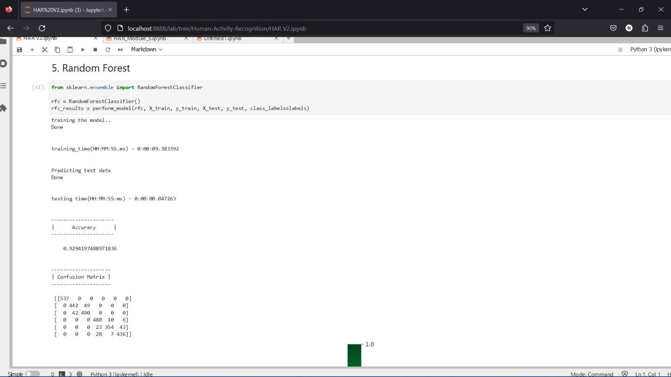
Module 7: Accuracy results of Random Forest Algorithm

Slide 33
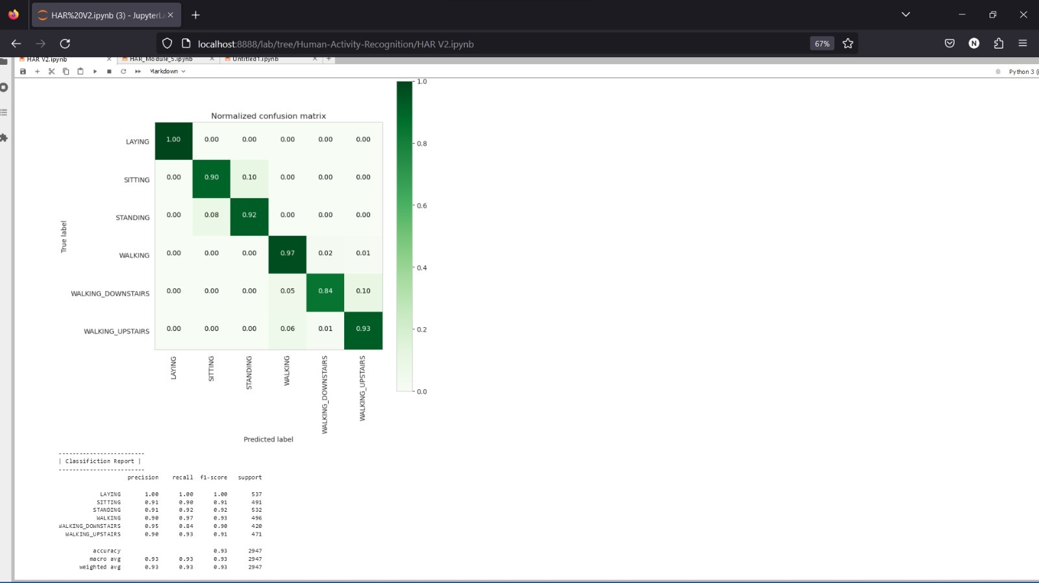

Slide 34


Slide 35
Observation
We got 91.75% test accuracy. From confusion matrix we can clearly see that, there are more of wrong predictions between standing and sitting classes. By observing tsne plot we have observed that these two classes are overlapped. And also there are more wrong predictions between walking, walking downstairs and walking upstairs classes. By observing tsne plot we have observed that these three classes are overlapped.

Slide 36
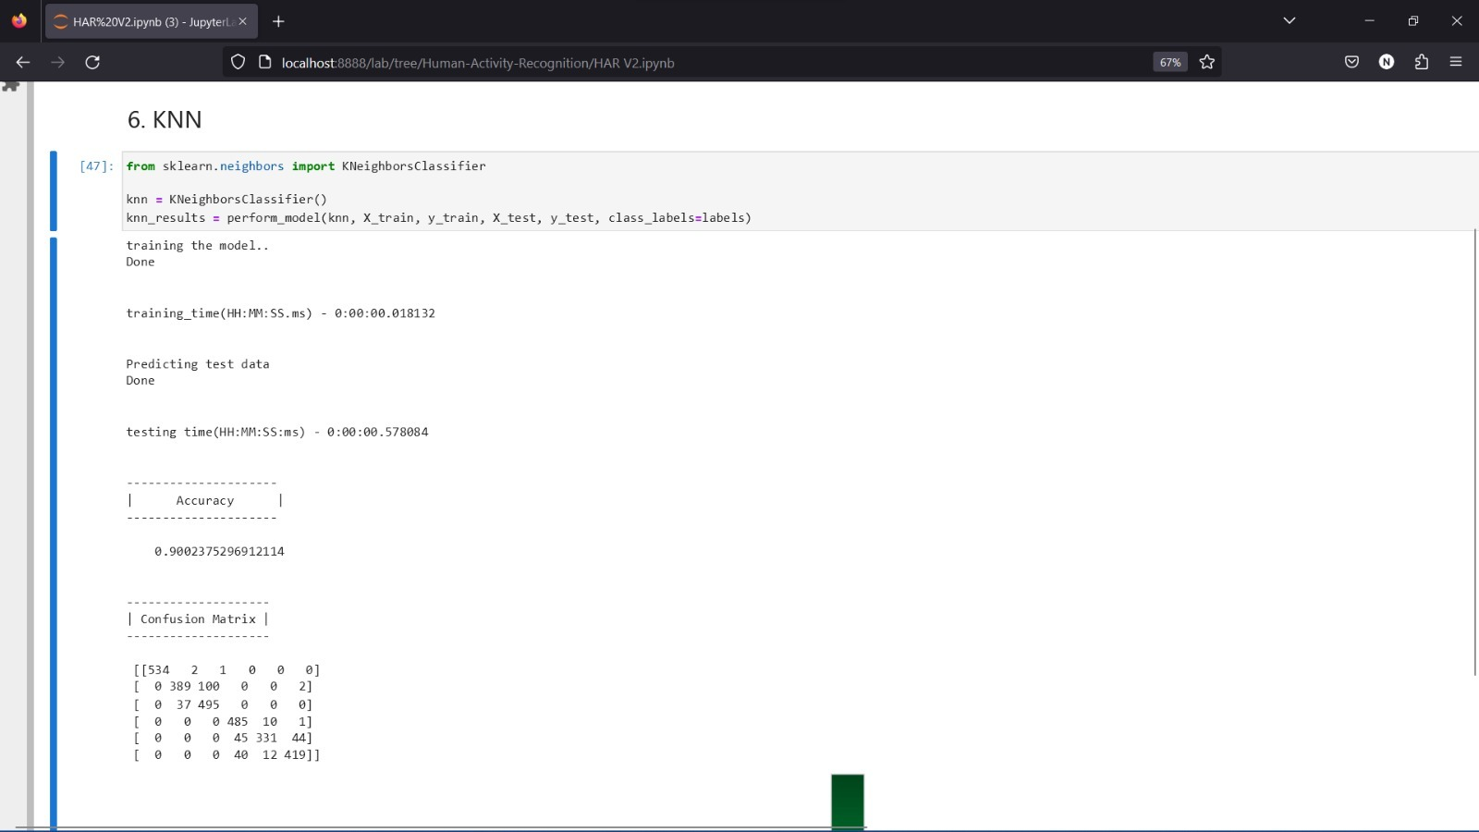
Module 8 : Accuracy and the results of KNN Algorithm

Slide 37
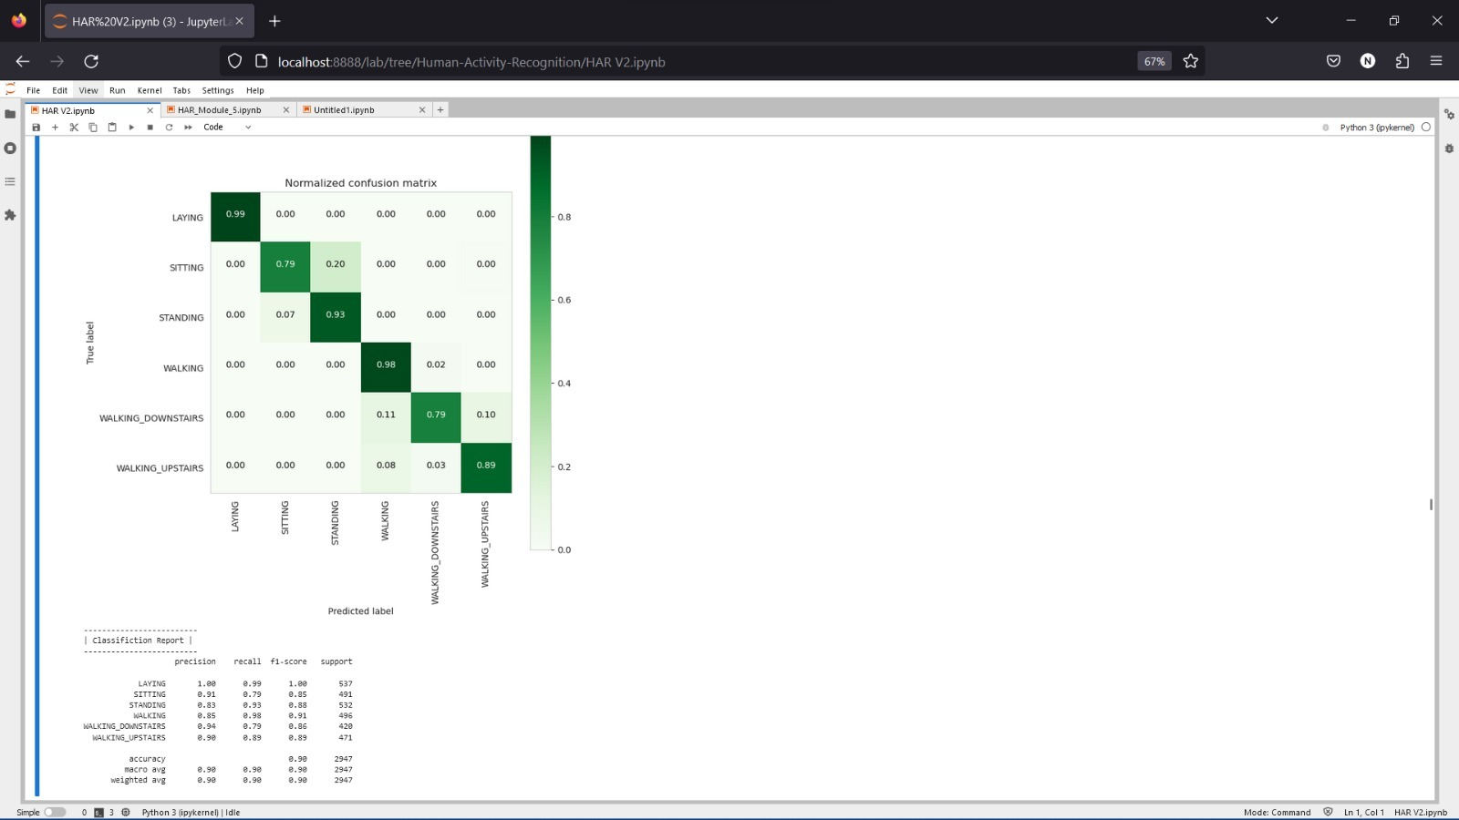

Slide 38


Slide 39
Observation
We got 89.71% test accuracy. From confusion matrix we can clearly see that, there are large number of wrong predictions between standing and sitting classes.By observing tsne plot we have observed that these two classes are overlapped. And also there are more wrong predictions between walking, walking downstairs and walking upstairs classes. By observing tsne plot we have observed that these three classes are overlapped.

Slide 40
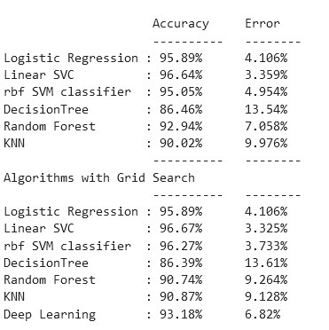
Module 9:Comparison between performance of all the algorithms

Slide 41
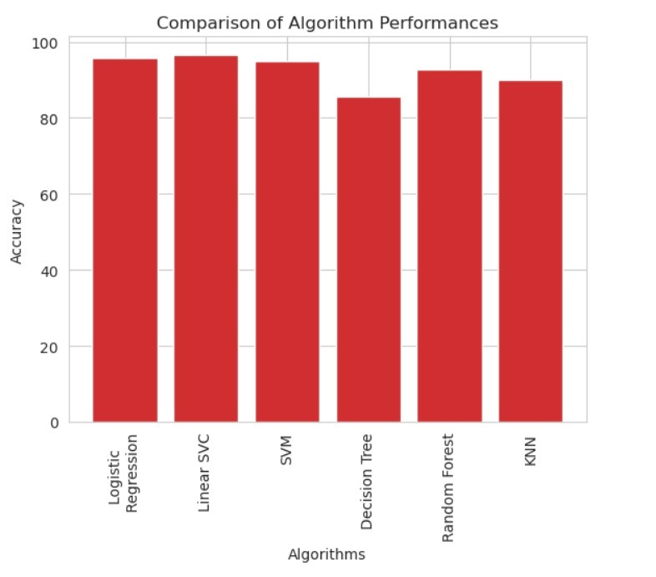

Slide 42
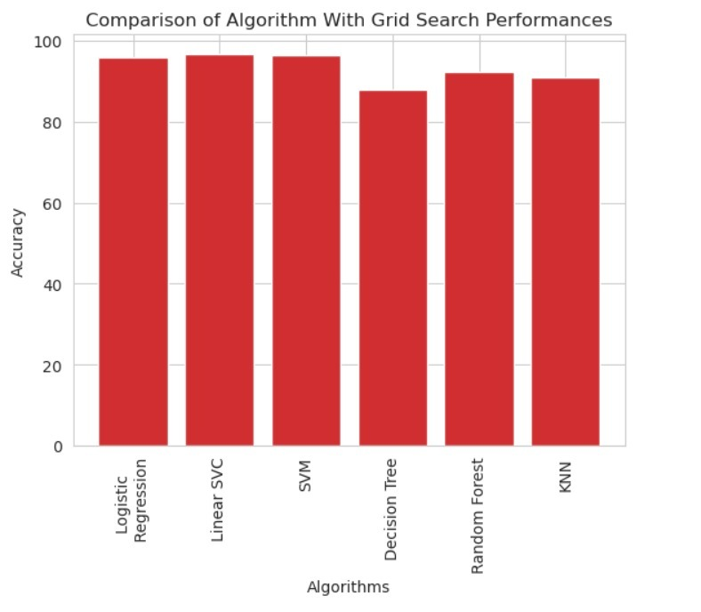

Slide 43
Conclusion
The analytical process started from data cleaning and processing, missing value, exploratory analysis and finally model building and evaluation.
The best accuracy on public test set is higher accuracy score is will be find out. This application can help to Recognize the human activity based on smart phone sensors.

Slide 44
Future Work
Human Activity Recognition connect with AI model.
To automate this process by show the prediction result in web application or desktop application.
To optimize the work to implement in Artificial Intelligence environment.

Slide 45
References
1. Aminian, K and Robert, Ph and Buchser, EE and Rutschmann, B and Hayoz, D and Depairon, M Physical activity monitoring based on accelerometry: validation and comparison with video observation, Medical & biological engineering & computing, 1999; 37:3-304
2. Bao, Ling and Intille, Stephen S, Pervasive computing, Activity recognition from user-annotated acceleration data, 2004, Springer.
3. Casale, Pierluigi and Pujol, Oriol and Radeva, Petia, Human activity recognition from accelerometer data using a wearable device, Pattern Recognition and Image Analysis,2011;289, Springer.

Slide 46
4.Sarah Fallmann and Johannes Kropf. (2016) “Human activity recognition of continuous data using Hidden Markov Models and the aspect of including discrete data.” Intl IEEE Conferences 121-126.
5.M. Humayun, Kabir M., Robiul Hoque, Keshav Thapa, Sung-Hyun YangTwo-Layer Hidden Markov Model for Human Activity Recognition in Home Environments.

